Slide 1
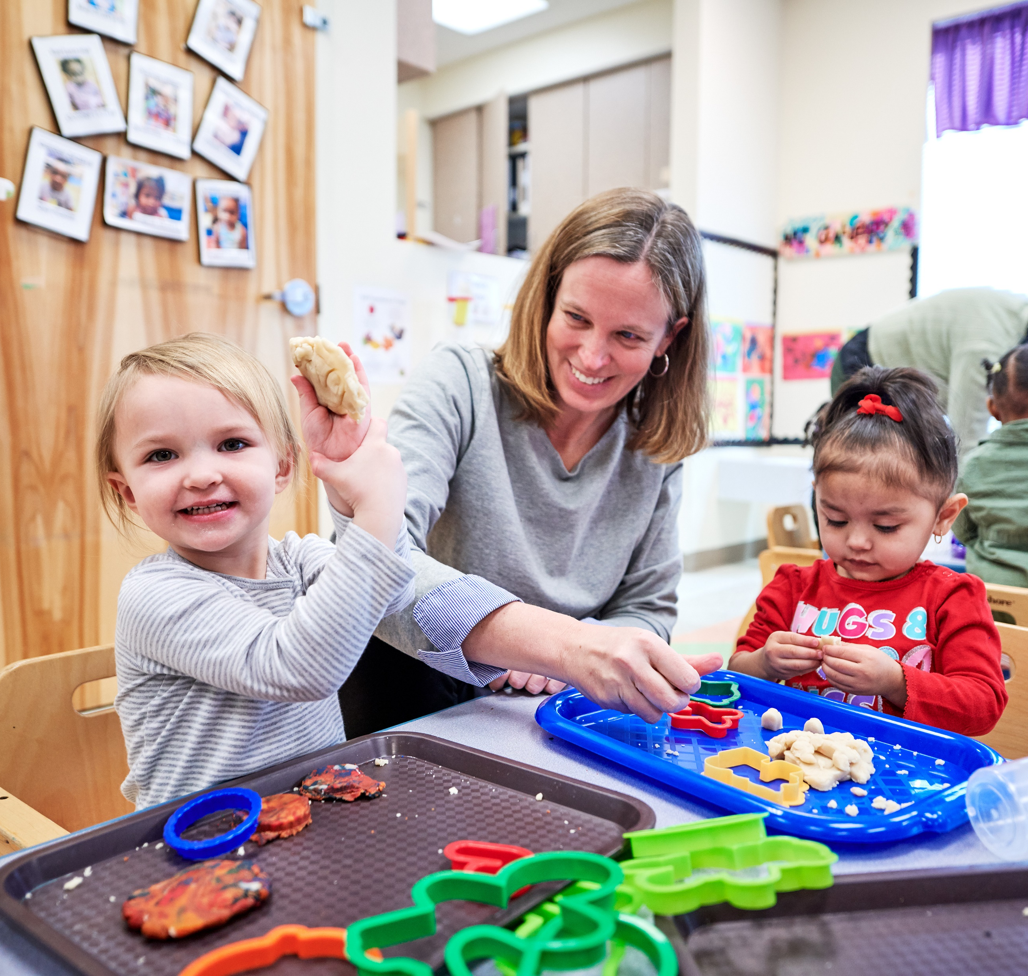
Peer Play Strategies: Making an Impact on Social Reciprocity and Communication for Autistic Preschoolers
March 14th, 2025 KCART, Overland Park KS
Dr. Kathy Bourque, PhD thiemann@ku.edu
Janet Weaver, MA janet.weaver@ku.edu
Riley Timmons riley.timmons@ku.edu

Slide 2
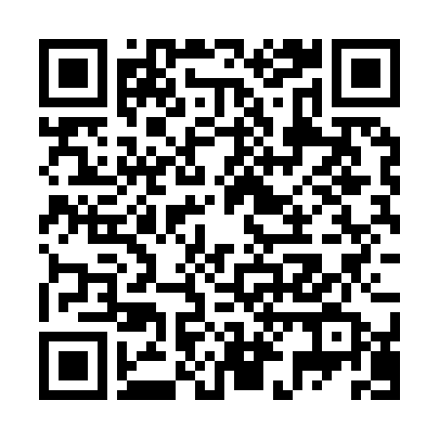
Notes:
Before we begin, please take a moment to scan this QR code. It will connect you to a list of references, our contact details, the JGCP website, and a link to these presentation slides. We’ll share the code again on the final slide.

Slide 3
Project Coding Team:
Stacy Johner
Katie Liskey
Sev Tatli
Notes:
JW
This video shares the experience of 3 speech-language pathologists who are lead implementers in our current study examining a peer-mediated intervention in the KC metro area.
This school year we’re in 5 school districts where we coach early service providers to provide a peer intervention to 13 autistic preschoolers and 24 peer buddies.

Slide 4
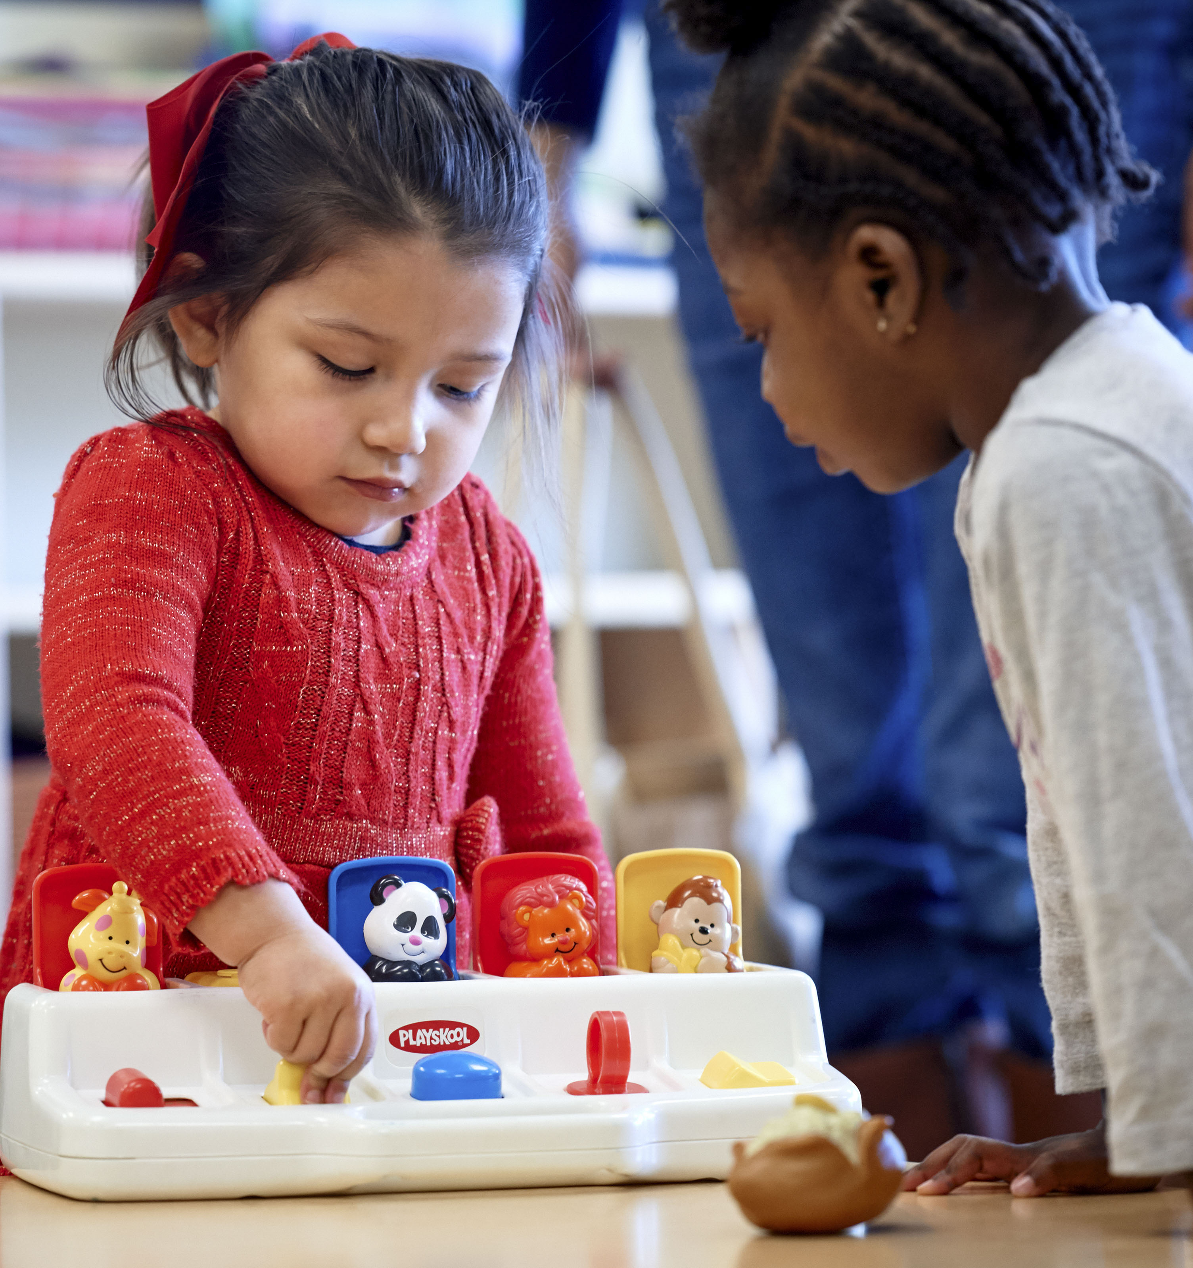
Agenda
Testimonies
Rationale for Incorporating Peer Play Strategies
Setting Up the Environment
Strategies to Teach Peers to be Responsive Play Partners
Observing and Measuring Social Progress
NIH. NIDCD R01 DC020418-01
Notes:
KB

Slide 5
School Staff Testimonies
Notes:
JW

Slide 6
Rationale for Incorporating Peer Play Strategies
Notes:
JW

Slide 7
Peer Partners
Reinforce positive social behaviors
Model language
Fun factor: Rewarding for all
Reciprocal Communication
Model play skills
Understand child behaviors
Peer-Mediated
Peer Networks
Notes:
In our preschool study, we refer to our peers as peer buddies, but you may also hear terms like peer partners, peer-mediated learning or peer networks. This language varies across age groups and what field you may be working in.
So why is it important to involve peers in play?
Most important reason is modeling. Children learn from observing and imitating other children. Young peers can learn to model language and play skills. They also reinforce positive social behaviors, such as sharing, taking turns, accepting changes in routines.
Play is also meant to be fun! Our goal is to create an environment where children enjoy playing together while also learning. The children who participate in these play groups, become more socially competent, leading to higher rewards and increased internal motivation to stay engaged, and learn new skills.
And finally, reciprocal communication, the back-and-forth exchange, depends on the skills of both partners. This is such an important area of development that has not received as much attention, in the classroom or in research. Which is something Kathy will dive into this more in just a bit.

Slide 8
Peer Characteristics (2-3 peers)
Follows simple 2-step directions
Comfortable talking to other children
Appropriately approaches or invites other children to play
Is well-liked by other children
Takes turns and shares toys
Responds to adult requests to modify undesirable behaviors
Offers to help other children
Notes:
JW
We don’t expect you to apply all the peer strategies you learn today to all your students. That’s not feasible at this stage. Instead, identify 2 or 3 peers to work with your focus student and develop the group from there.
This list of characteristics is based off the literature and hours of observations with prior children in Kathy’s studies. A responsive peer would meet the majority of these criteria, perhaps not all – read list
Peers are involved for the school year and take turns playing with the autistic child. This helps the children become familiar with each other, the routines, and possibly develop friendships.
Some teachers ask if language or articulation delays would exclude a student—but we’ve had peer buddies with these challenges and did great with a bit more teaching and reinforcement.

Slide 9
Setting up the Environment
Notes:
JW
Once we have our peers, now it’s time to talk about the environment.

Slide 10
Setting up the Social Environment
Very important to set the STAGE for:
  Engagement – need to be motivated, socializing is work
  Observational learning – imitation of peers increases learning
  Opportunities to respond – once per minute minimum
  Communication – both initiating/starting and responding
Notes:
JW
When setting up a social environment it needs to be First, engaging. The activities we choose are motivating and interesting to the child. This means figuring out what toys child prefers. However, it’s a balance—if child is too fixated on a particular toy (e.g., loves cars but refuses to share), the activity might be highly motivating for them but not enjoyable for their peers. On the flip side, you want the peer to be interested and not bored. Choices are important.
Next, is observational learning, children learn by imitating their peers. We've also observed peers learn important skills too for example, they learn children communicate in different ways, and how to read potentially communicative behaviors (both positive and challenging)
Finally, opportunities to respond and communication, relates to the back-and-forth exchanges, where both children have chances to initiate and respond. Ideally, we want children to communicate at least once per minute.

Slide 11
Structured Table Play
Notes:
JW
Our research works with autistic preschoolers ages 3-6 years with limited or no spoken language who are either already using or could benefit from an iPad as a speech generating device. In the videos we share you’ll see the iPad is always on the table and accessible to the autistic child.
Children participate in 24 treatment sessions, each 30-min. Before treatment, we observe what the children can do on their own, or baseline behaviors. We structure the play environment by being at the table, often in a quiet room with minimal distractions, and introduce one toy at a time. We select preferred activities to increase engagement. Intervention sessions include reviewing peer play strategies only with the peer for 5 min, then 15 min encouraging/prompting the peer to initiate and create a communication opportunity with autistic child, then a few minutes of feedback.
View BL clip: The peer is on the left in both clips. iPad is available to use.
View Post Observation clip: Now we will view a clip of the children after 10 treatment sessions.
Audience question: What did you see related to social interaction? Did you observe any changes in communication?
BL: peer playing on own, FC watching but no communication happening; louder environment
Post Obs:
Quieter location
More communication: Peer is saying name, asking child what he wants. FC is responding and requesting with iPad
Turn taking improved
Both no adult at the table, no prompting.

Slide 12
How would you change the set up of the environment to improve engagement?
Notes:
JW
Now, let’s look at unstructured settings—
Snack: watch video, stop and brainstorm as a group how to change/improve set up to improve engagement
Free Play: watch video, stop and discuss

Slide 13
Strategies to Increase Engagement
Snack Time
Free Play
Centers
Children have jobs – napkins, cups, plates
Assign child to be in charge e.g., giving items, pouring
Set up reasons to communicate – tight lids, only give 2-3 pieces at one time
Functional play - often at this play level; C/E
Pretend play- imitation of play sequences; use pictures to show
Cooperative play – more social roles, rules, and turns expected
Child preferences – motivating but not TOO much
Clear beginning and end to activities, what are the rules?
Consider how many children in one area
Notes:
JW
Let’s share some specific strategies…
First, Snack – give each child a job to do; child can in charge of passing out snacks, handing out napkins or plates, or pouring drinks. This creates natural opportunities to communicate whether for items or more snacks. Could also include laminated photos of preferred activities on placemats to give them something to comment on rather than just requesting.
Free Play – include lots of cause and effect toys, simple rules; child’s pretend play is likely imitative so we encourage using visuals. As children’s play skills develop we see more cooperative play which involves more rules and turn taking
Lastly, Centers – choose activities that are motivating but not too much. Clearly define beginning and end of activity so children know what to expect. Think about how many children are in a center, smaller groups more engaged play
By using these strategies, we can create a more engaging environment where children are interested and communicative.

Slide 14
Selecting Engaging Activities
Spin stick
Cars on ramp
Puzzle
Bubbles
Free Play
Parts in containers or clear bags
Peer is in charge, only give as many as they can ‘handle’ and still listen
Switch roles of who ‘gives’ toys when child is ready (can trigger)
Teach peer 3-2-1 STOP, with toys that have sound/can turn on or off
Functional play - often at this play level; C/E
Pretend play- imitation of lay sequences; use pictures to show
Cooperative play – more social roles, rules, and turns expected
Notes:
RT
A big part of creating engaging activities is finding toys that make it easy to set up many communication opportunities. The spin stick, car racer toys, puzzles, and bubbles are some that we’ve found that improve back-and-forth reciprocal interactions. Each one has multiple parts that can be controlled by you.
CLICK To set up an interaction, First all parts are placed in a container or baggie so everyone can see them, not spread out on table.
CLICK Next, you tell peer they're in charge of the parts and to Hold them and Wait.
CLICK In the beginning giving may be challenging for an autistic child, but gradually you practice them having a turn giving and being in charge.
CLICK Finally, we teach our peers “3, 2, 1, stop!” for those toys that require the peer to turn it on or off, like a bubble machine. Depending on the toy, you may need to modify to create the back-and-forth opportunities. For example, you can use switch-adapted toys and a 3, 2, 1 stop prompt.

Slide 15
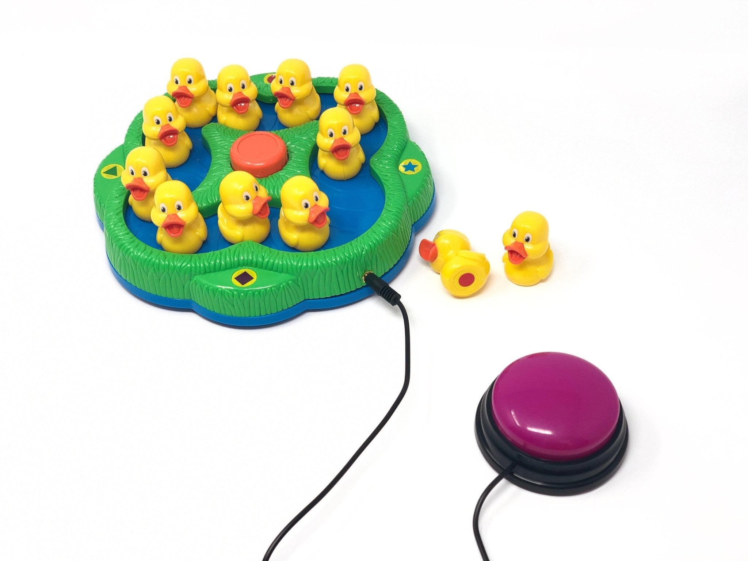
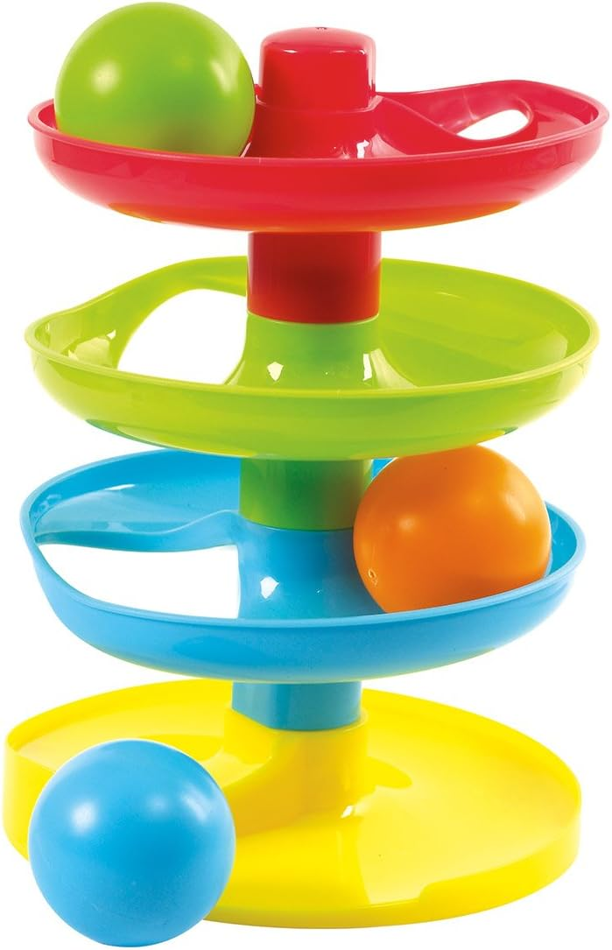
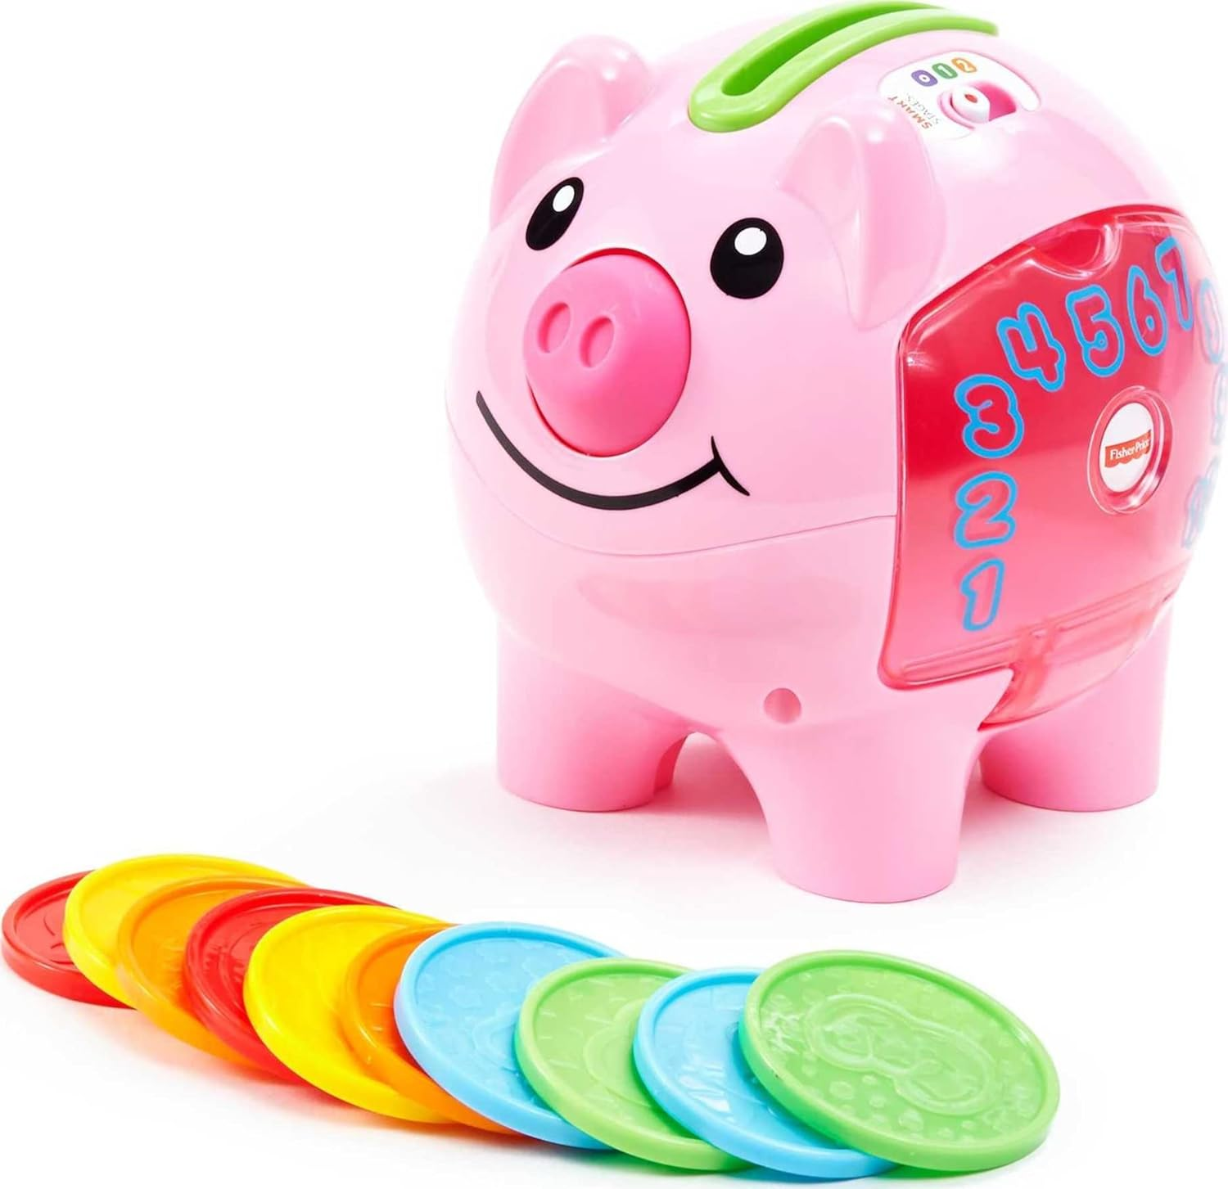
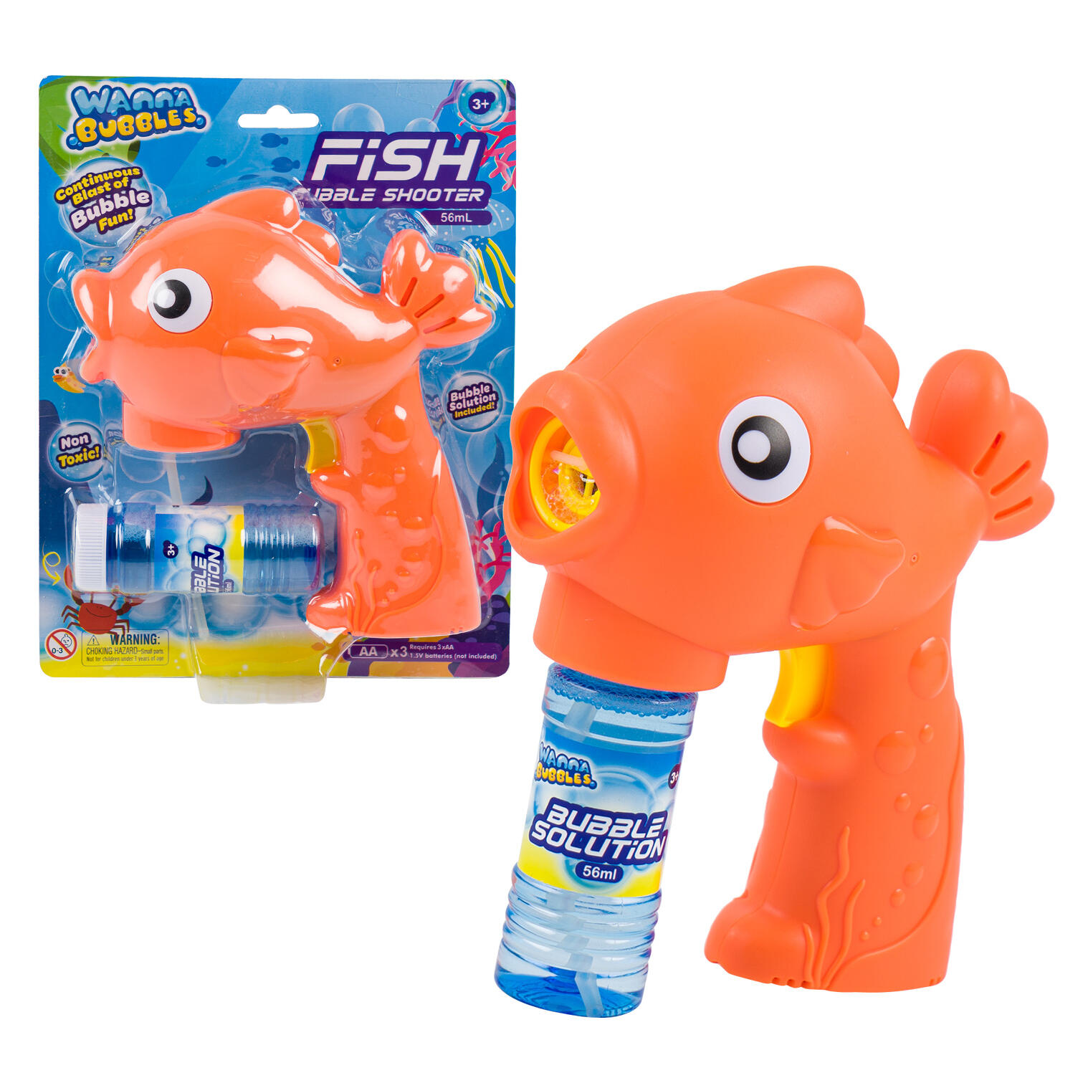
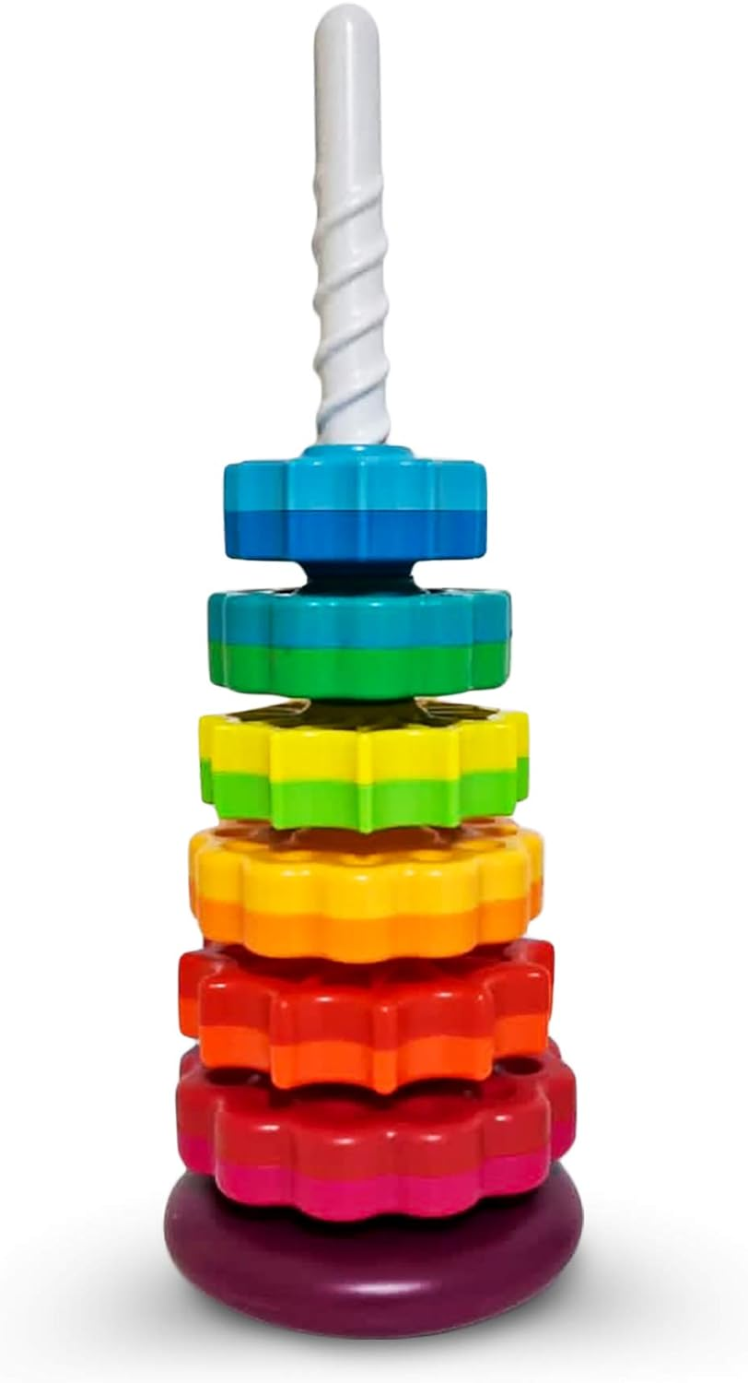
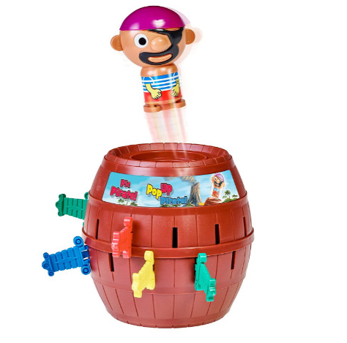
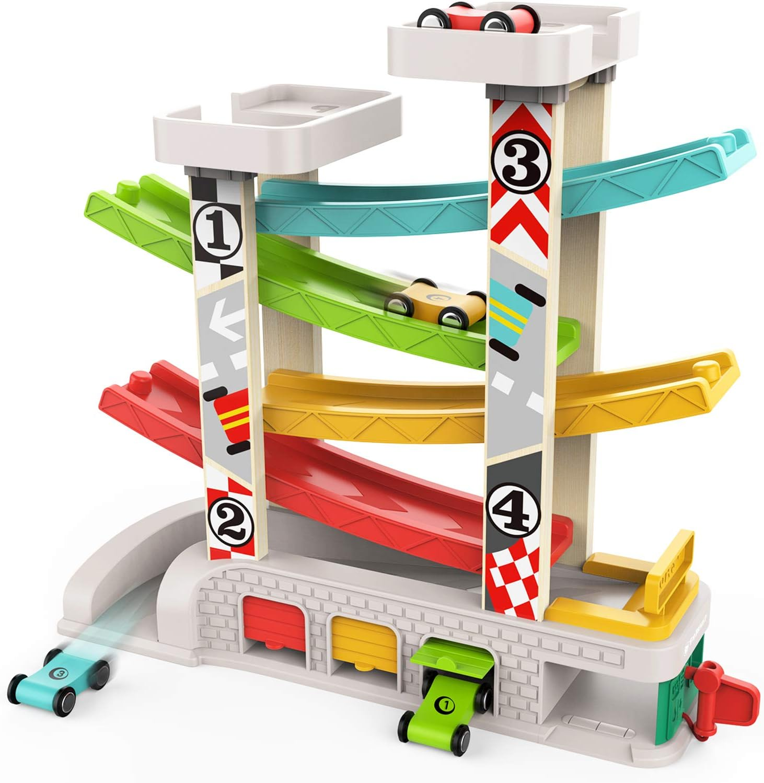
Notes:
RT
Here are some of the toys and activities we’ve found that lead to communication and are engaging for both children.
The main toy is in between the children and peers start by asking the child what they want. The autistic child responds with request and the peer gives them a piece, and repeat. Then switch roles. For bubbles and switch-adapted toys, the peer is in charge of making the toy go.

Slide 16
Less-Engaging Activities
Less structured
Can build or do their own thing with no need to interact (solitary play)
More planning/thought needed to:
Control what is available (one color vs. five of play doh)
Create shared activities for cooperative play
Reasons to communicate (e.g., add a cookie sheet or an oven for the play doh; build a block fence for animals)
Play Doh
Legos
Blocks
Play food
Free Play
Functional play - often at this play level; C/E
Pretend play- imitation of lay sequences; use pictures to show
Cooperative play – more social roles, rules, and turns expected
Notes:
RT
CLICK Some activities, like play doh, legos, blocks, and pretend play are a bit more difficult to set up engaging play.
CLICK These toys can be more tricky because there may be no reason to communicate or it turns into parallel or solitary play without a shared goal or activity to do together.
CLICK To make these activities more engaging, you can be more intentional in setting up play routine by controlling what is on the table or giving children specific roles. For example, one child has the play doh and is in charge of distributing it, and the other child has the cookie cutters, and is in charge of making shapes. Mainly – you want to make sure there are reasons for the children to take turns interacting and communicating.

Slide 17
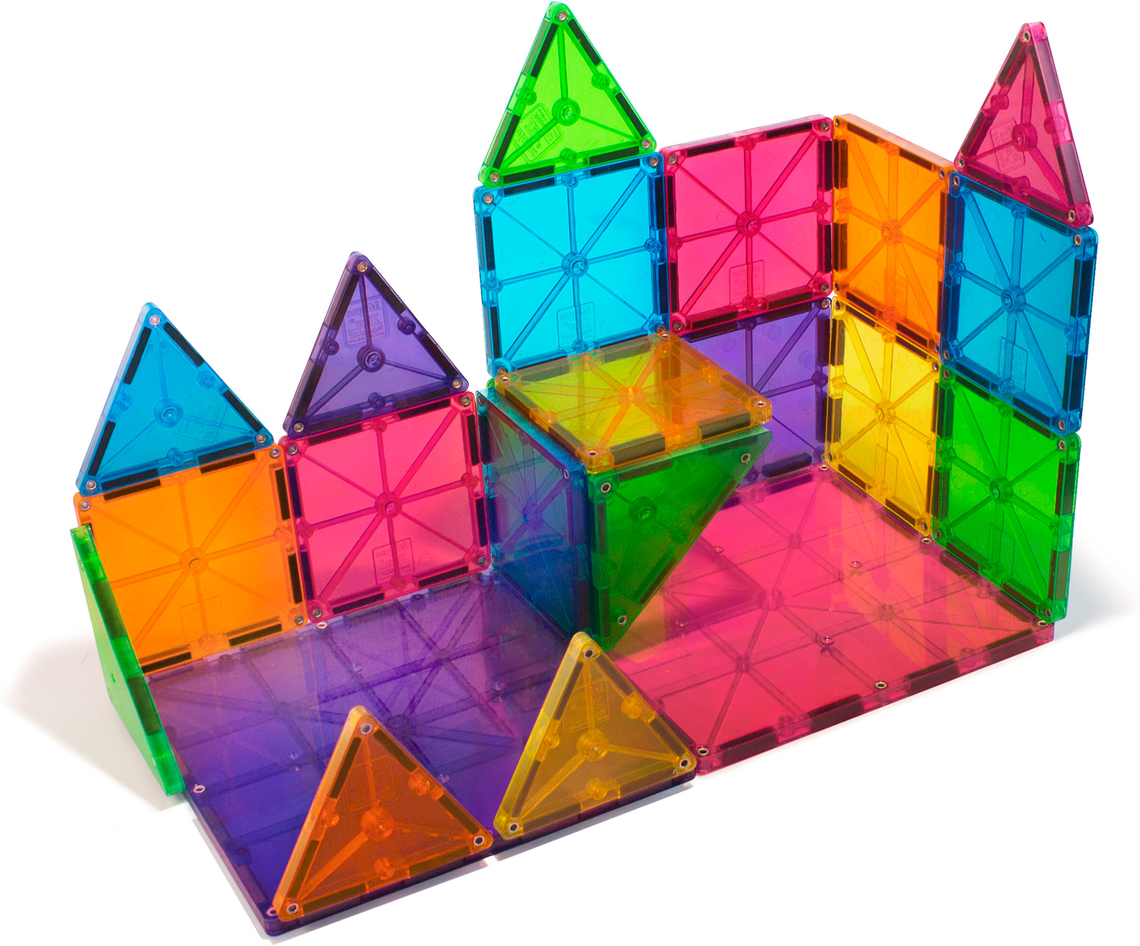
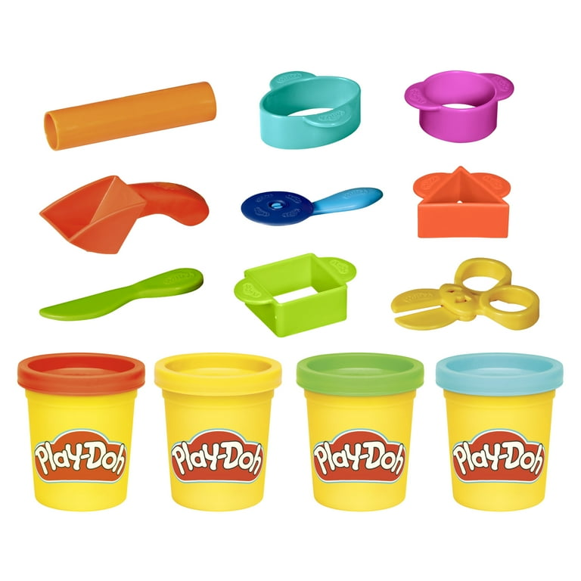
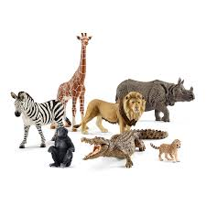
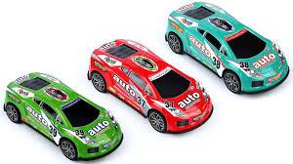
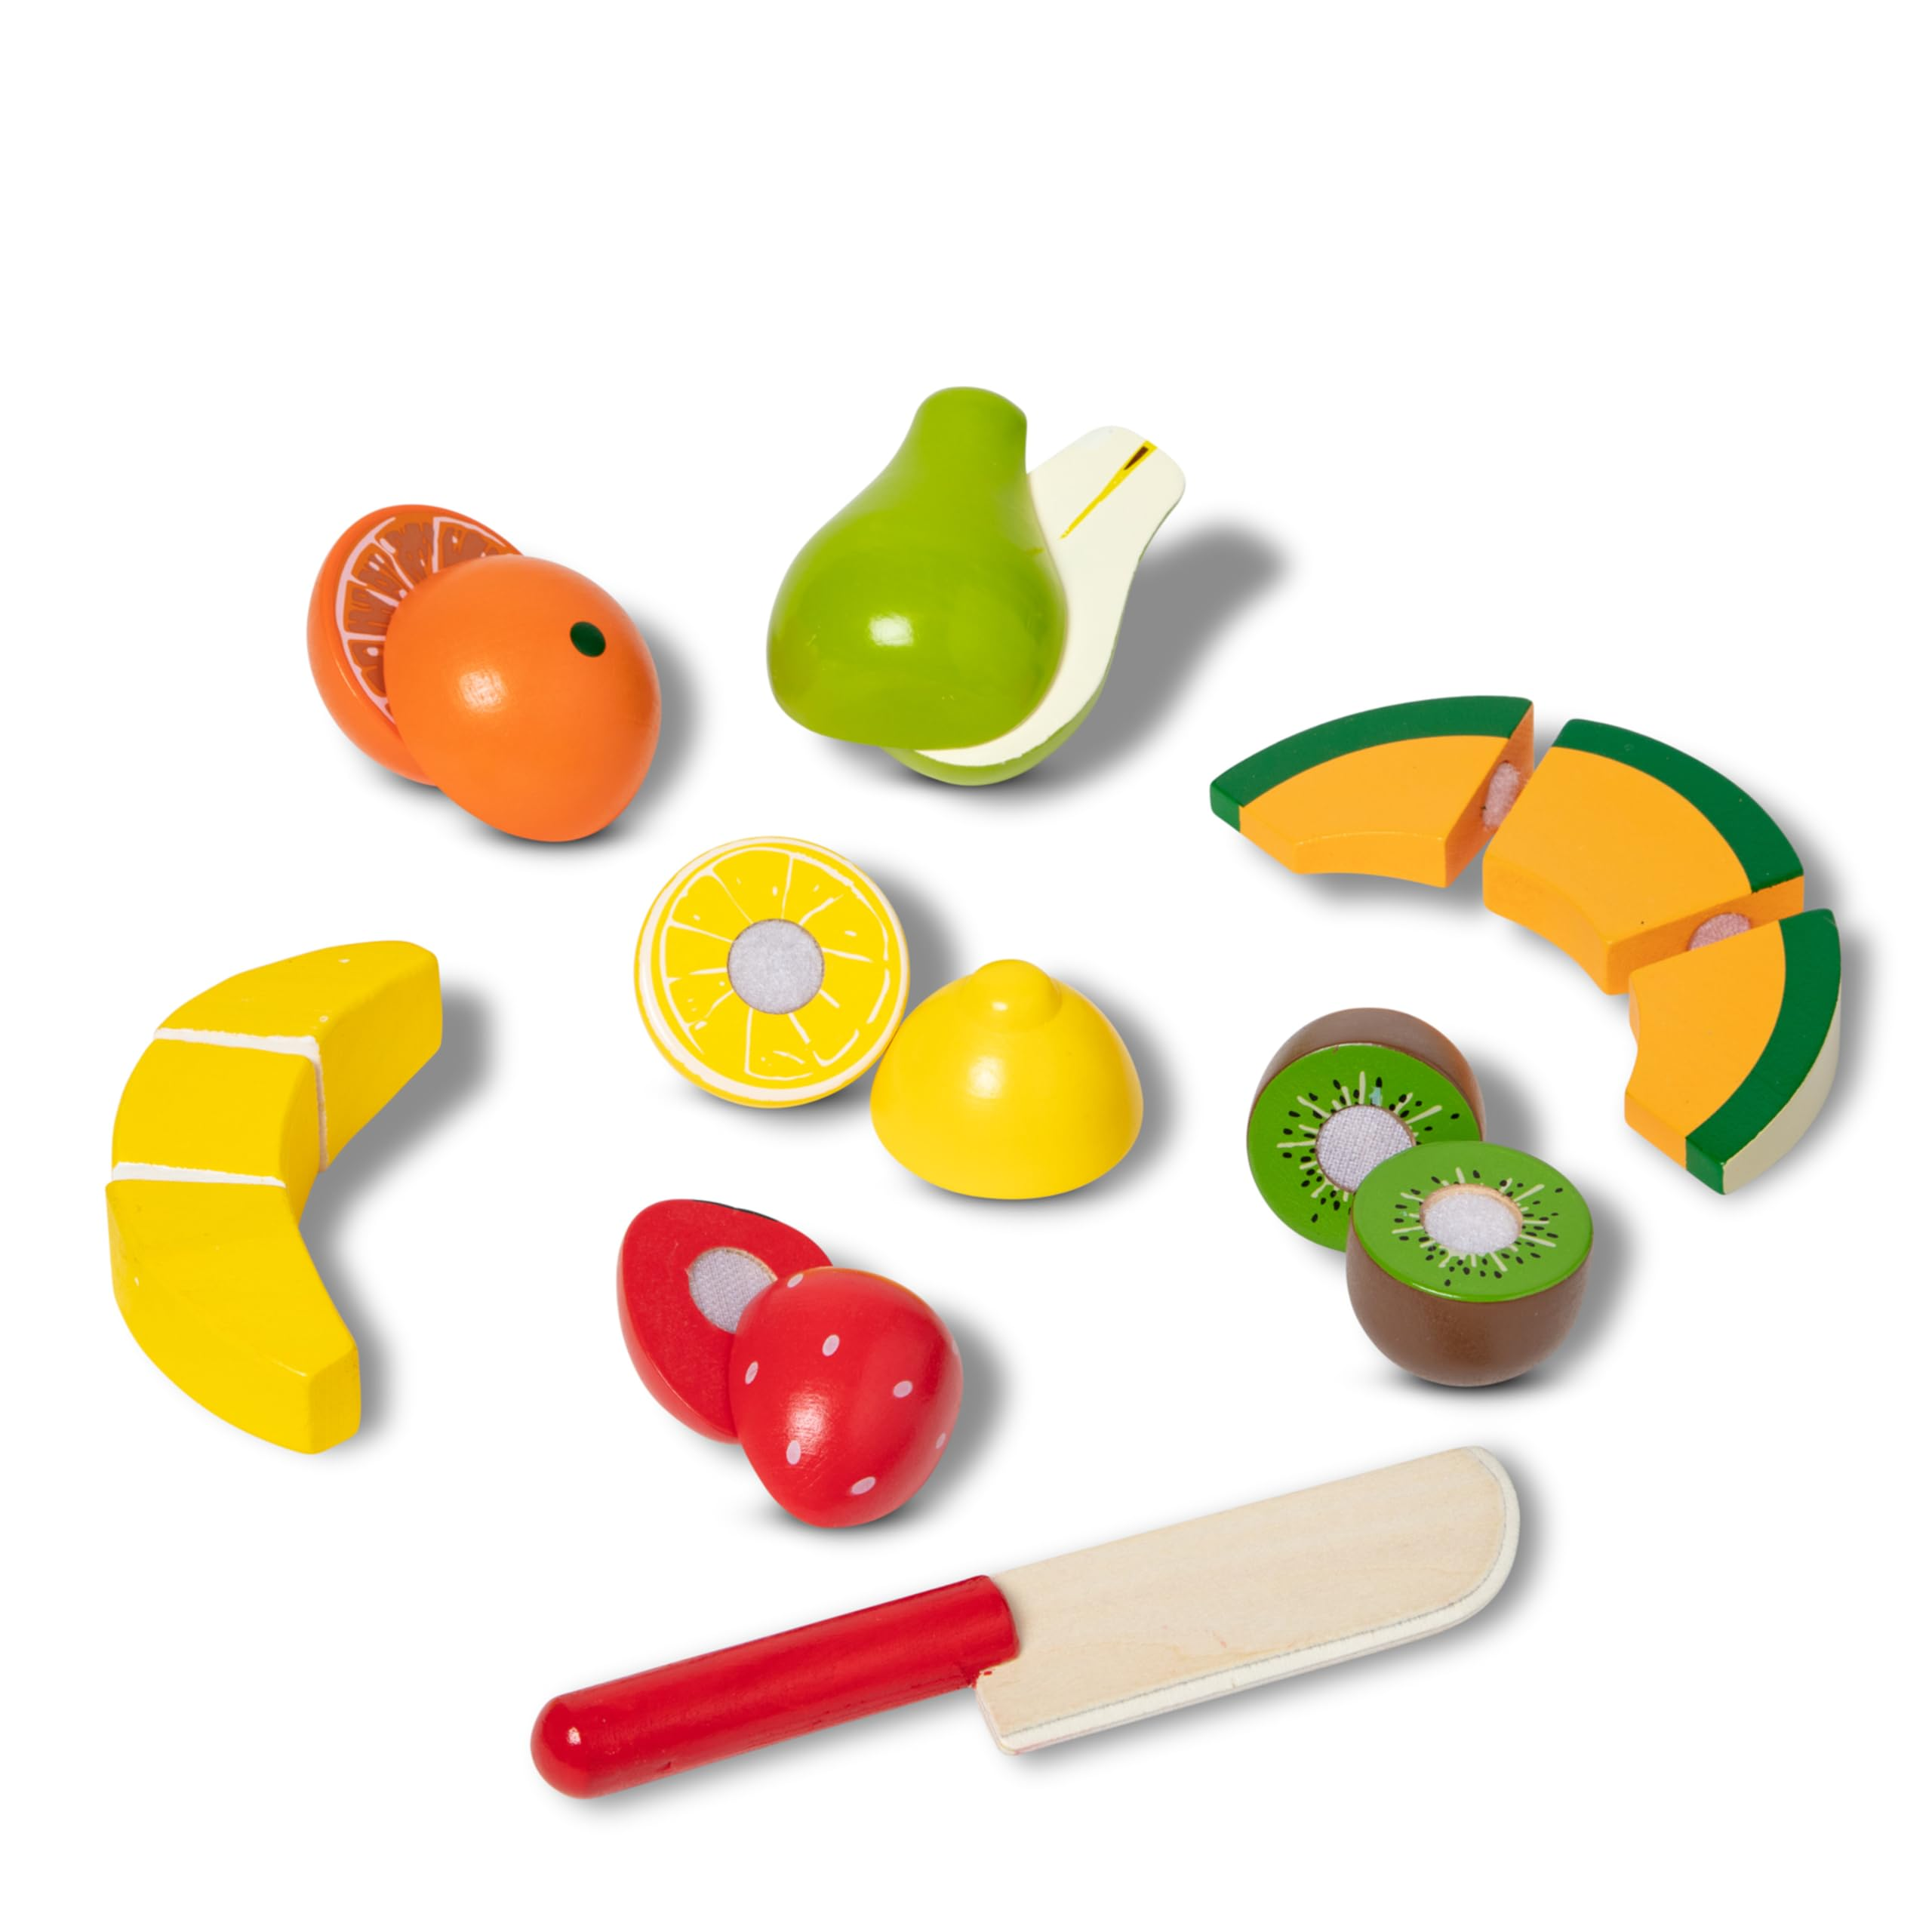
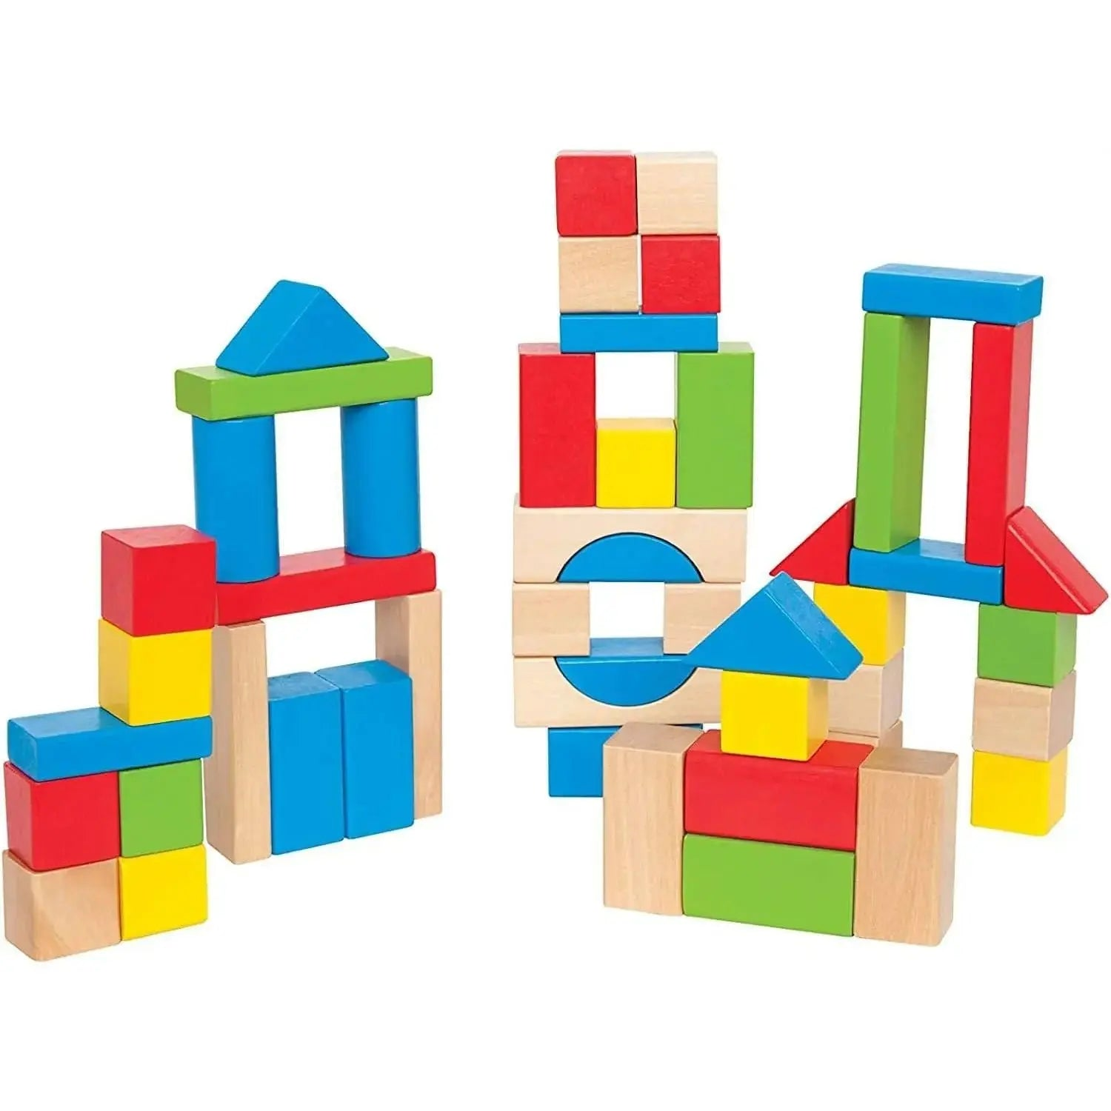
Notes:
RT
You can also add in specific toys or items to create shared goals. For example, after the children build a tower of blocks, you introduce cars for them to crash into the tower. After the children build a fence with the magnatiles, you can add animals, then introduce shredded paper as food for the children to feed the animals. Being intentional about the play routine will increase opportunity for communication.

Slide 18
Strategies to Teach Peers to be Responsive Play Partners
Notes:
RT
Now let's explore some strategies you can teach to peers to be responsive play partners.

Slide 19
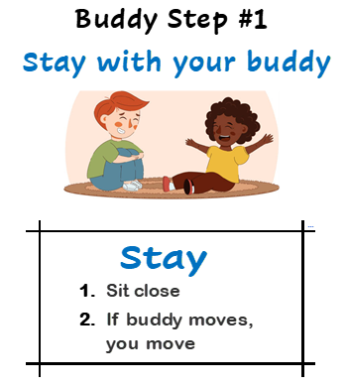
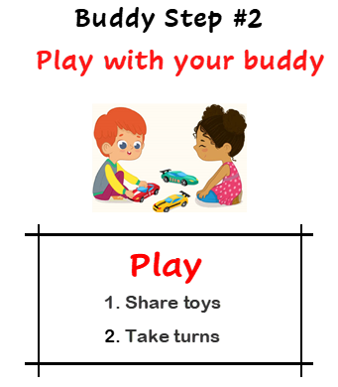
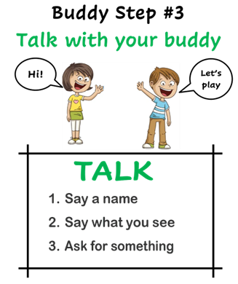
Stay-Play-Talk Buddy Steps
(Goldstein et al., 1997; Thiemann-Bourque et al., 2016; 2018)
Notes:
The strategies we teach peers to be responsive play partners are to stay, play, and talk with their buddy. Peers each have a buddy book with the steps. We teach peers to stay with your buddy by sitting close and moving if your buddy moves...(outline each substep of all three steps).
To learn these skills, peers watch adult models, practice with the adult, then practice with their buddy. Stay and Play comes easily, so we spend more time on prompting the peer to talk and model language. These strategies were initially published in the late 1990’s, and the work Kathy has done at Juniper over the last 15 years has adapted them to meet the needs of children with limited or no spoken language. References are available through the QR code on the last slide.

Slide 20
Talk: Get Buddy’s Attention
  Say name
  Tap on shoulder
  Do it again
Notes:
RT
At the beginning, our children are mostly talking to the adult and using ‘he, she, they’ to describe their buddy, instead of talking directly to them. To encourage talking directly to the buddy, we teach our peers to say their buddies name to get their attention. Some children may not respond to their name right away. As an additional way to get their buddies' attention, we teach our peers to tap their buddy on the shoulder. You can encourage your peers to try again if their buddy still isn’t listening to them. Let's take a look at what this skill looks like in practice. You're going to see the peer saying her buddy's name while tapping her on the shoulder and trying again when it doesn't work the first time. When she directed a comment to the adult, the adult prompted her to talk to the child to reinforce these skills.

Slide 21
Hold and Wait
  Hold two items up in front of child
  Give toy FAST
  Do it again
Notes:
RT
Lastly, we teach our peers to hold and wait. This is a very important communicative gesture that sets up opportunities for children to request toys. Peers are taught to hold one or two items (depending on the toy) up in front of the child so they can clearly see their options. Once their buddy asks for something, they're taught to give them the toy fast. This immediately reinforces the child for requesting something and leads to more successful back-and-forth communication. In these videos, you're going to see a peer who was taught to recognize ASL 'more' request, as it's the child's preferred method of requesting. She knows the routine of holding a toy and waiting, giving it to him fast when he signs, then preparing the next choice with another hold and wait.
VIDEO 2 IF TIME
By only giving him the colored ball he requested, this peer is helping the autistic child learn and decipher colors on his SGD device! She's giving him the toys fast when he asks and holding and waiting repeatedly for more communication.

Slide 22
Observing and Measuring Social Progress
Notes:
KB

Slide 23
Observing and Measuring Progress
Total communication acts
Expressive language acts
Initiations and responses
Spontaneous
Peer-directed
Consider the context
  Table play, snack, free play, recess, centers, transitions
How many peers in the group?
How many choices of toys?
Preferences and interests
  Strike a balance; start with whatever works

Slide 24
Communication Acts Coded
Behavior | Definition
Speech | Communication using spoken language that matches the context; must orient to the peer or the shared activity to be intentional communication
SGD | Child intentionally pushes a symbol on the iPad then orients back to the peer or the shared activity (shifts attention away from iPad, not exploring iPad)
Speech + SGD | Child combines speech and SGD use by using both modalities simultaneously or within 3 seconds of each other
Gesture | Child uses any conventional gestures or nonverbal behaviors to communicate to the peer (e.g., reaching, giving, pointing, signing ‘more’ or ‘all-done’, push away or move peer hand/arm to protest or to say ‘all done’)
Vocalization | Potentially communicative acts that must contain a recognizable vowel sound and may contain a consonant sound; includes unintelligible acts
Notes:
KB- pick one

Slide 25
What does reciprocal communication include?
Who started to communicate?
Did the other child respond (within 3-5 seconds)?
  YES! How many turns did they take back-and-forth?
  NO. Start over, observe who starts to communicate
  *Some children are stronger at responding; children can learn to initiate when they are MOTIVATED to engage
Notes:
KB

Slide 26
Baseline Interaction

Slide 27
After 10 sessions

Slide 28
Treatment #16 (8 hours over 3 mon)

Slide 29
Reciprocal Communication Episodes
How many times did children participate in a multi-turn exchange?
Average/10 min sn for N=28 from BL to Observation #1
N=13 children (of the 28) at Observation #2

Slide 30
Reciprocal Communication Turns
How many turns did a child take within each multi-turn exchange?

Slide 31
Communication Change:
Rate per Minute
How many times did child initiate or respond to a peer within a 10 min session?
What do we expect/minute?
  Baseline Range: 0 to 1.3 acts/min
  10 Session Range: 0.3 to 4.5 acts acts/min
Notes:
Discuss range, responsiveness to intervention; current study allows us to measure progress after 10 sns, and if responding great, if not then may receive additional strategies for the next 14 sessions

Slide 32
Reasons to Communicate
Request for objects
Request for actions (more, spin it, turn on)
Gain attention
Comments
Social interaction (high-five, that’s funny)
Protest (stop, all done)
  *Often begin with requests; then comments and gain attention
Notes:
KB

Slide 33
Other Positive Outcomes:
Autistic Children
Increase in spoken and/or SGD vocabulary
Combine words and symbols
Play with wider range of toys
Make transitions easier
Fewer challenging behaviors
Smiles and engagement
Peer Partners
Responsive with other children
Express excitement when they see progress
Learn empathy and patience
Learn about how others communicate
Smiles and engagement
Notes:
KB

Slide 34


Questions and Discussion
thiemann@ku.edu
janet.weaver@ku.edu
riley.timmons@ku.edu
Juniper Gardens Children's Project | Juniper Gardens Children's Project
PIPA Project Home | Peer Interventions for Preschoolers with Autism (PIPA)

